Slide 1
Introduction to SharePoint Framework Extensions
Vesa Juvonen
Senior Program Manager
Microsoft
Waldek Mastykarz
MVP
Rencore

Slide 2
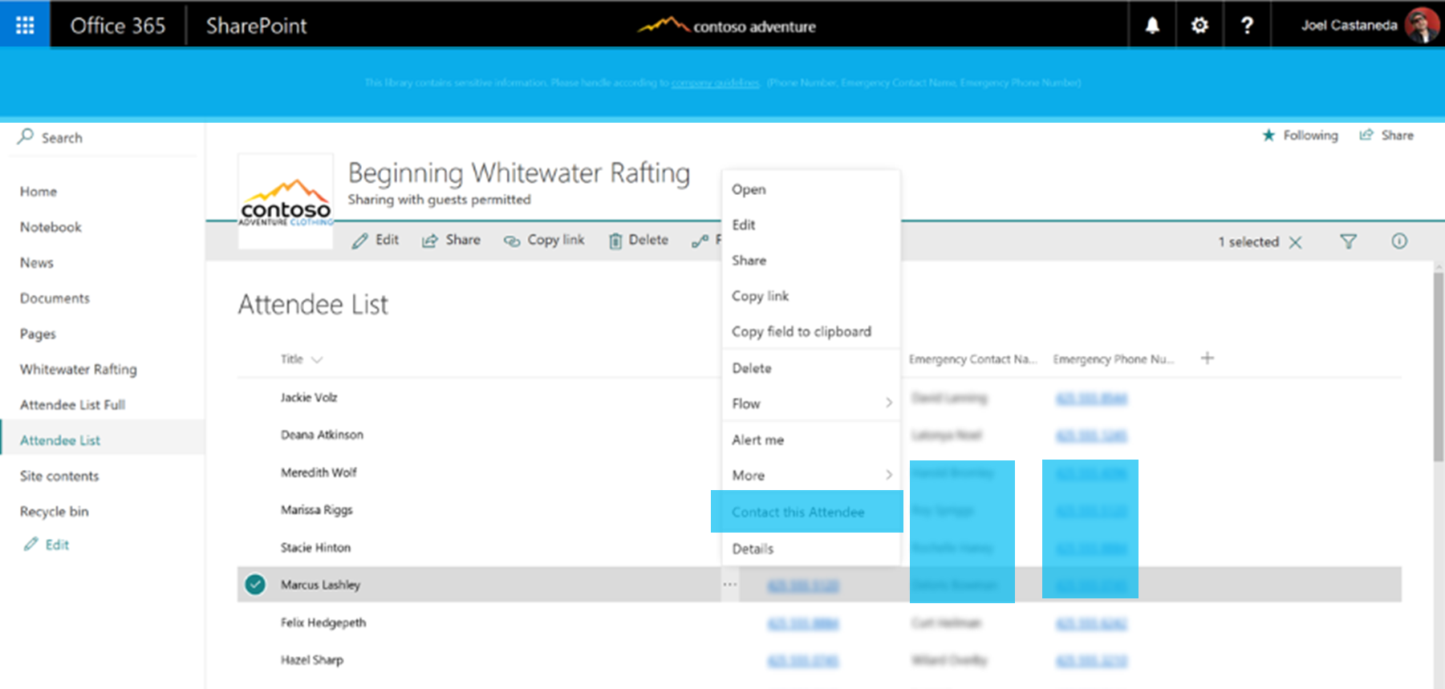
SharePoint Framework Extensions
Application customizer to extend UI or embed JavaScript
ListView Command Set for adding new buttons to toolbar or context menu
Field customizer to modify rendering of a field

Slide 3
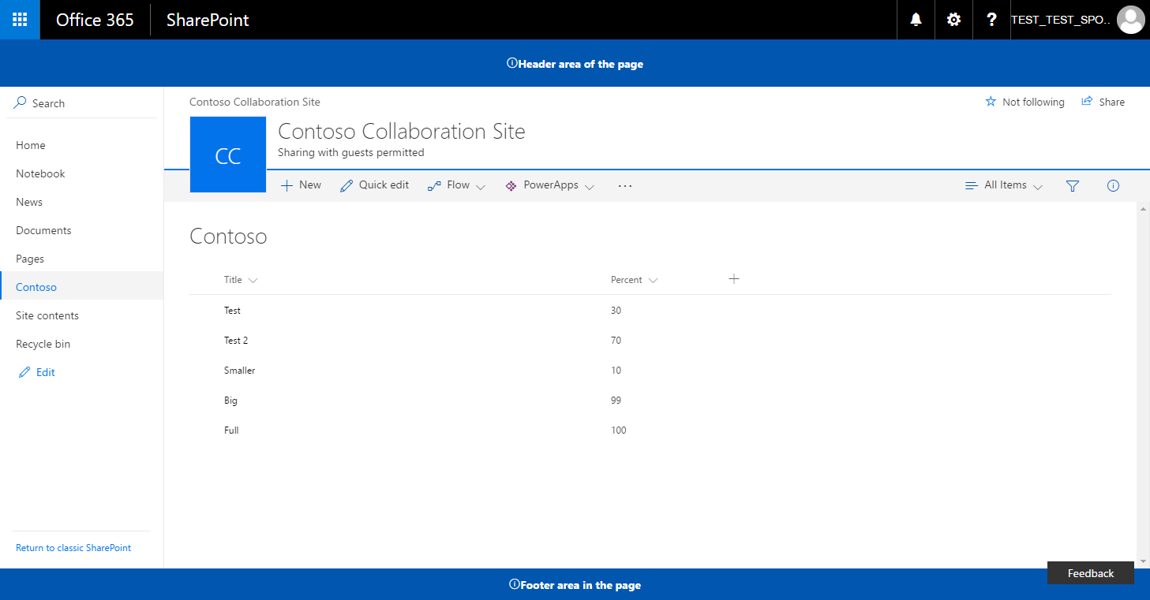
Logical architecture of an extension
SharePoint Online
SharePoint Framework Extension assets hosted from CDN. Could be also a folder or library in the SharePoint tenant, which acts as a centralized deployment location.
Extension
js
JavaScript Library
Extension

Slide 4
Application Customizer
Can be used to embed “visible” or hidden JavaScript on the SharePoint site
Can be associated to Site Collection, Site or a List scope
Associated ClientSideComponentId property at UserCustomAction collection

Slide 5
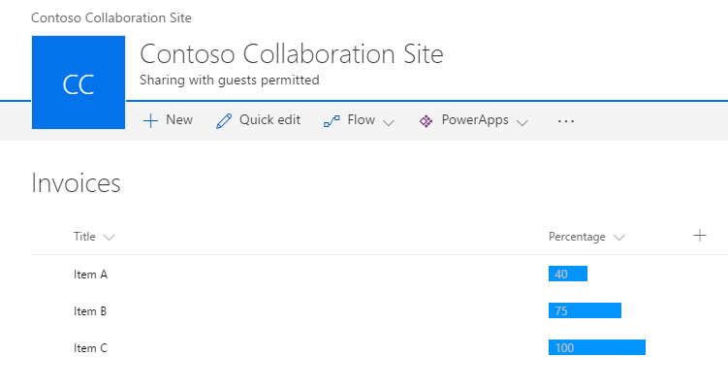
Field Customizer
Can be used to override field presentation in lists
Can be used with site columns or directly for a field in a list
Associated ClientSideComponentId property at Field object
Editing view experience override in the roadmap – June 2017

Slide 6
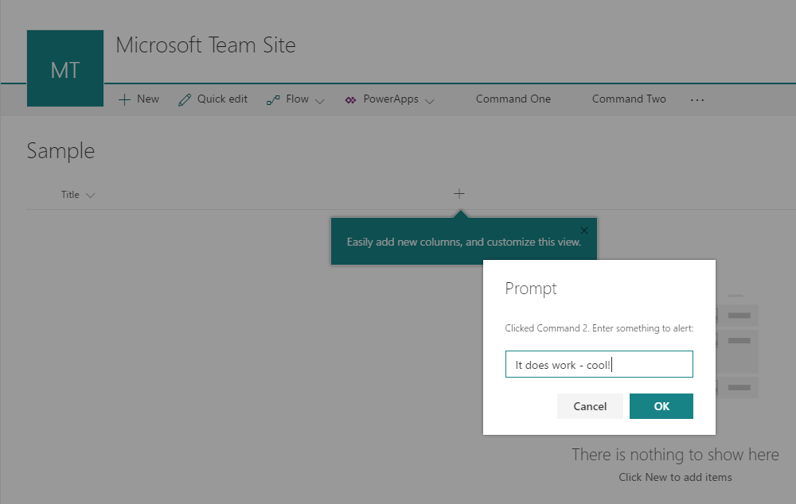
ListView Command Sets
ListView Command Set can be used to provide action buttons to lists
Supports toolbar and context menu
Associated ClientSideComponentId property at UserCustomAction collection
ListView Command Sets can be registered at site level to be valid for specific list types

Slide 7
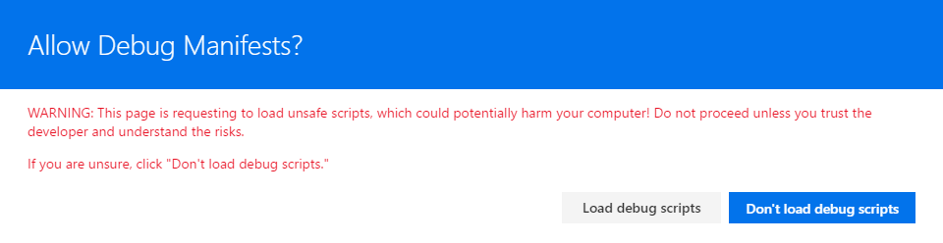
Debugging SharePoint Framework Extension
Debugging
Debugging happens in actual SharePoint Online sites
Code is hosted from the local web server - localhost
You can load your customization to normal pages using specific debug query parameters in browser
C
We are looking to have extension support also in SharePoint Framework workbench

Slide 8
DEMO
Developing SharePoint Framework Extension – Scaffolding, development, debugging

Slide 9
Deployment of an extension
Deployment
Test using debug query parameters
Decide CDN hosting location
Update target hosting URL for the solution and copy assets to CDN
Add solution package to app catalog
Install solution to site
Associate extension to be used with needed APIs – ClientSideComponentId in UserCustomActions or in SPField

Slide 10


